Slide 1

Web Applications
Chris Piech
CS 106B
Lecture 23
Mar 7, 2016
CS 106B
2011

Slide 2
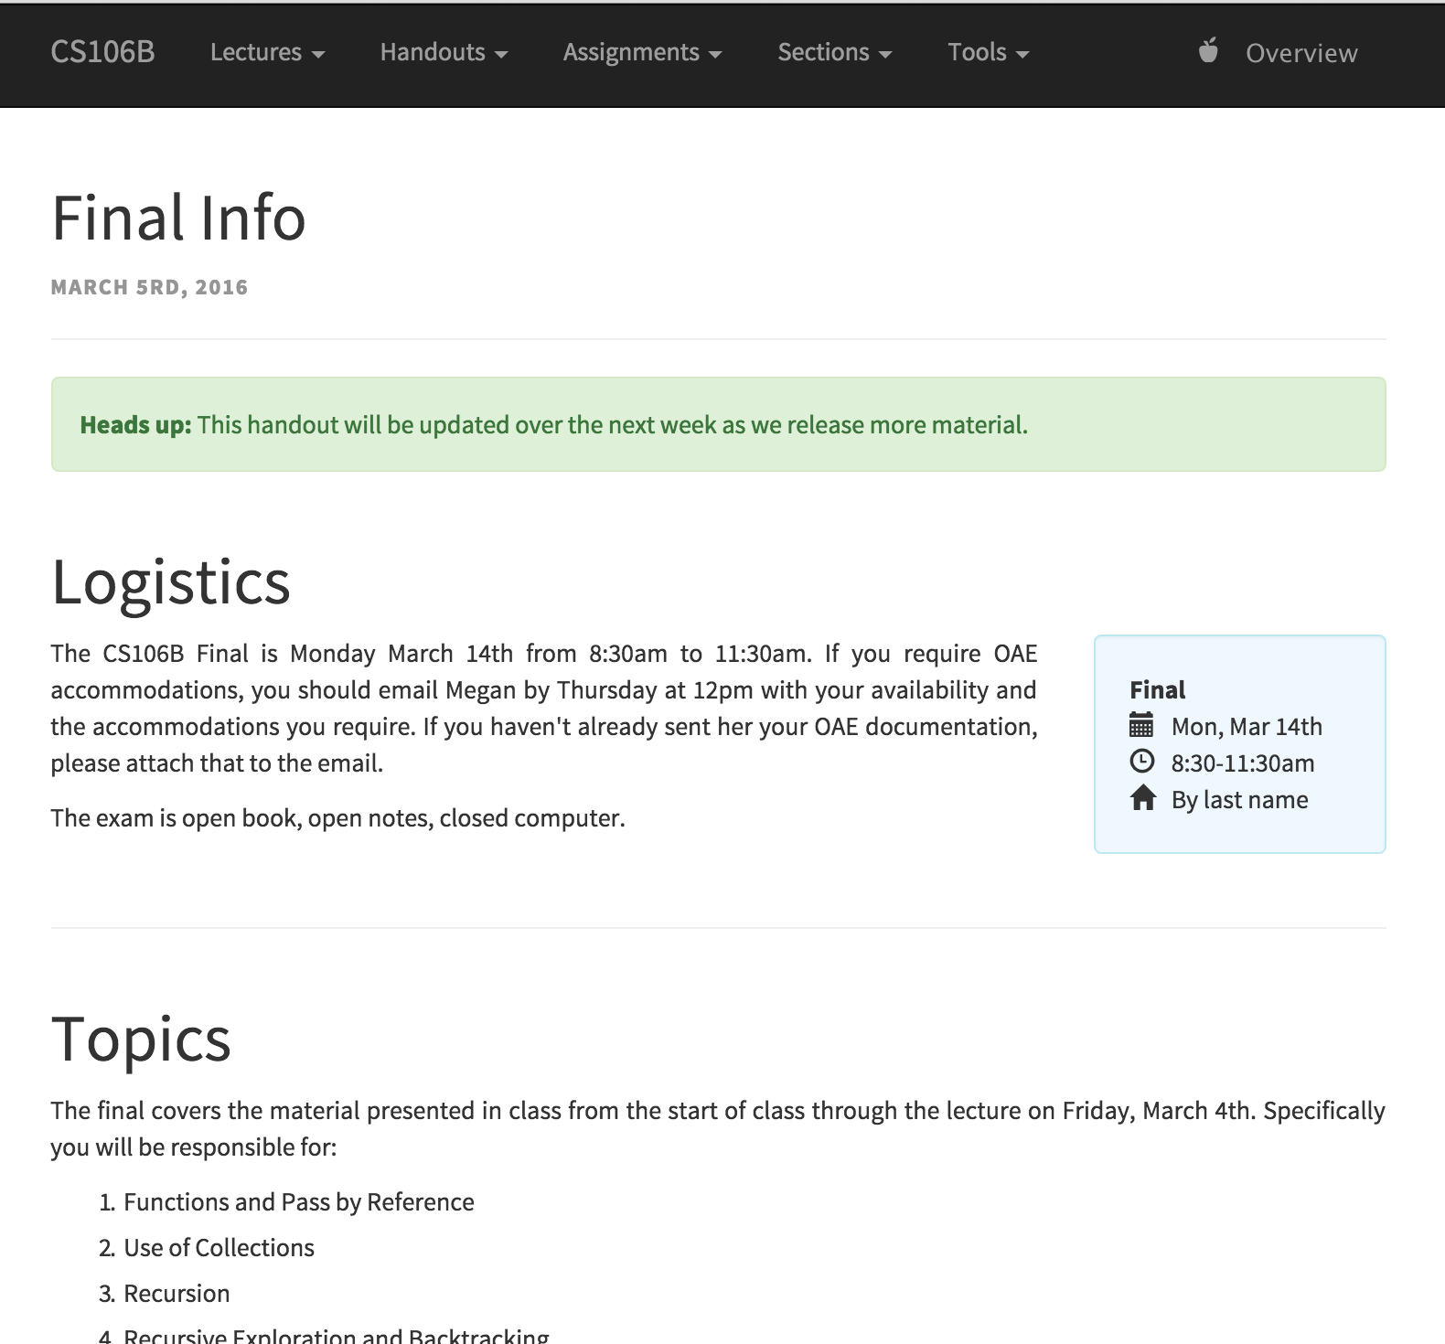
Final Info

Slide 3

Final Practice Sitting
*amandawritenow.com

Slide 4
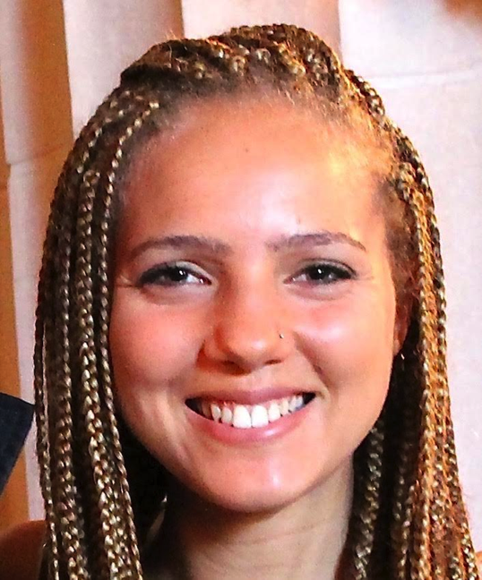
Thanks Megan

Slide 5
What are We Gonna Do?
1. Multilingualism
2. Real C++
3. What was CS106B and what is next?

Slide 6
Not inheritance

Slide 7

Special Guest Tomorrow

Slide 8

Today’s Goal
Multilingualism
How the web works
Javascript Ideas

Slide 9
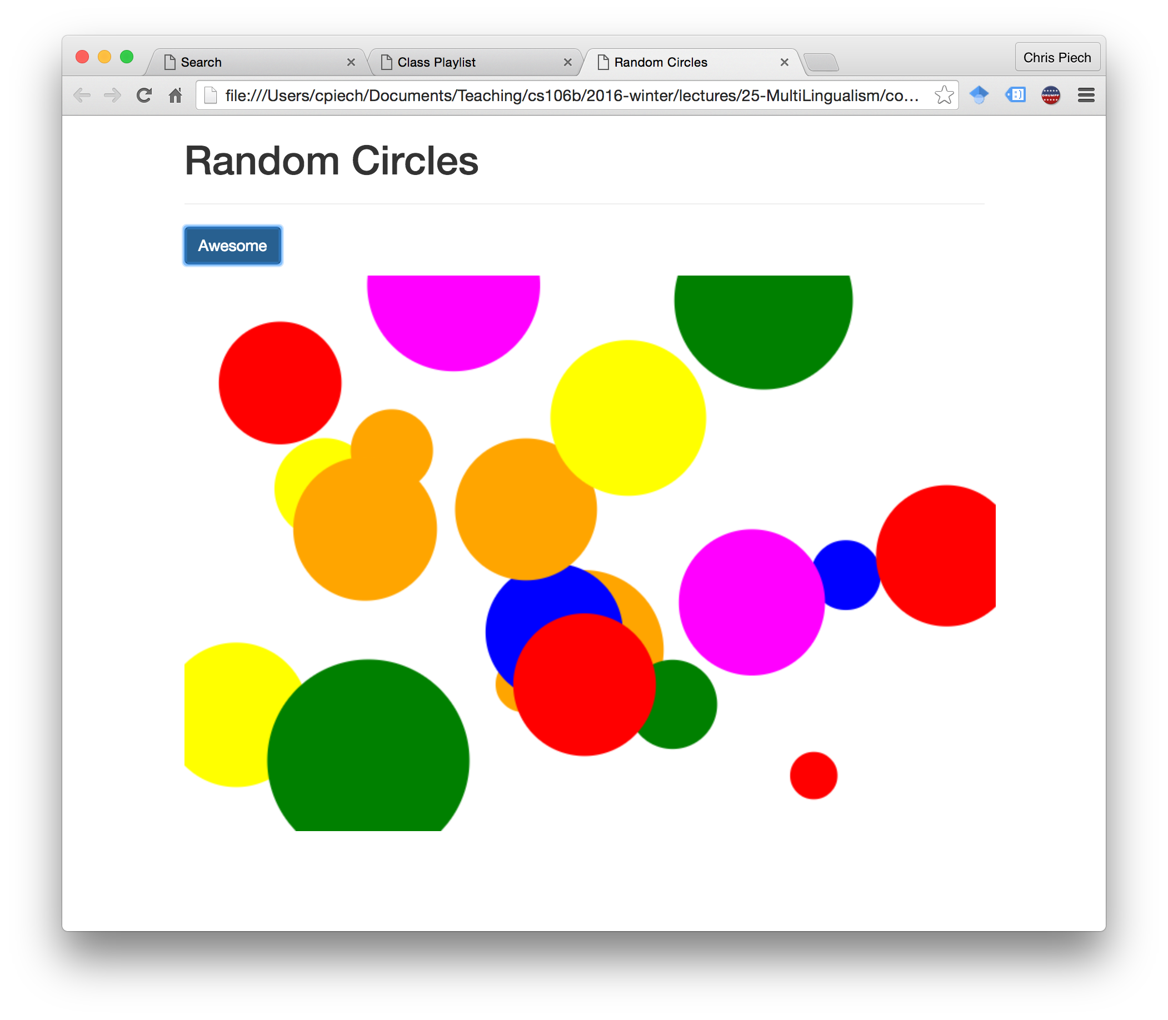
Program #1 Random Circles

Slide 10
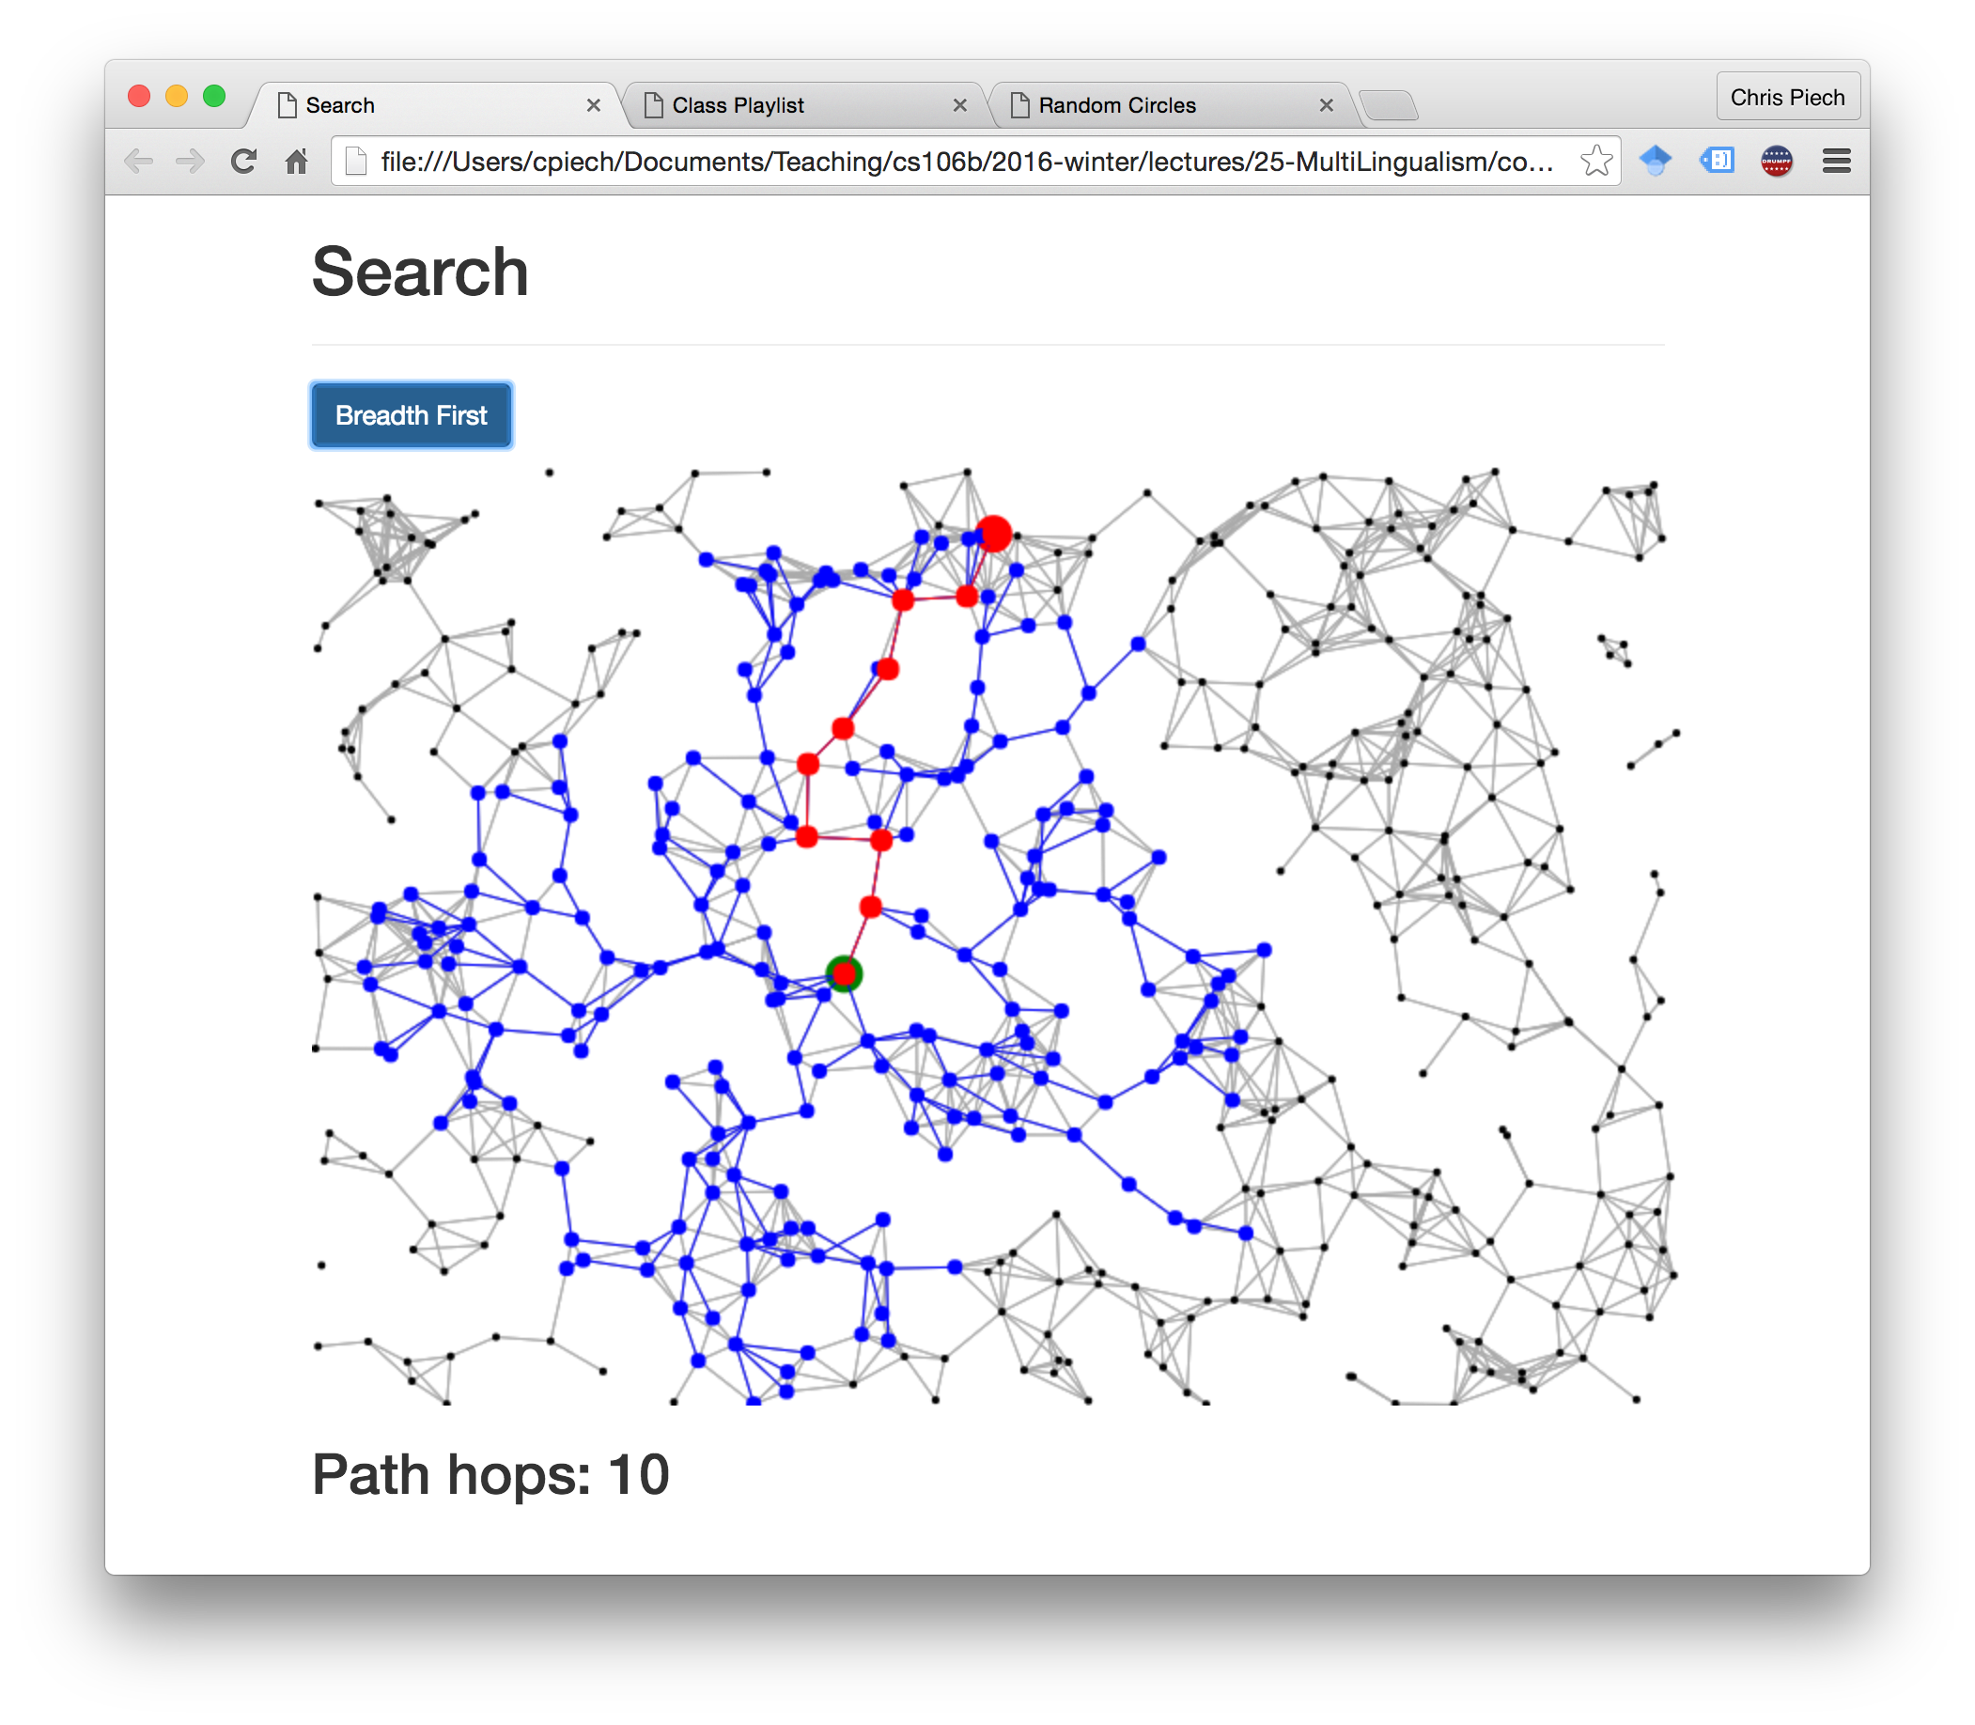
Program #2 Breadth First Search

Slide 11
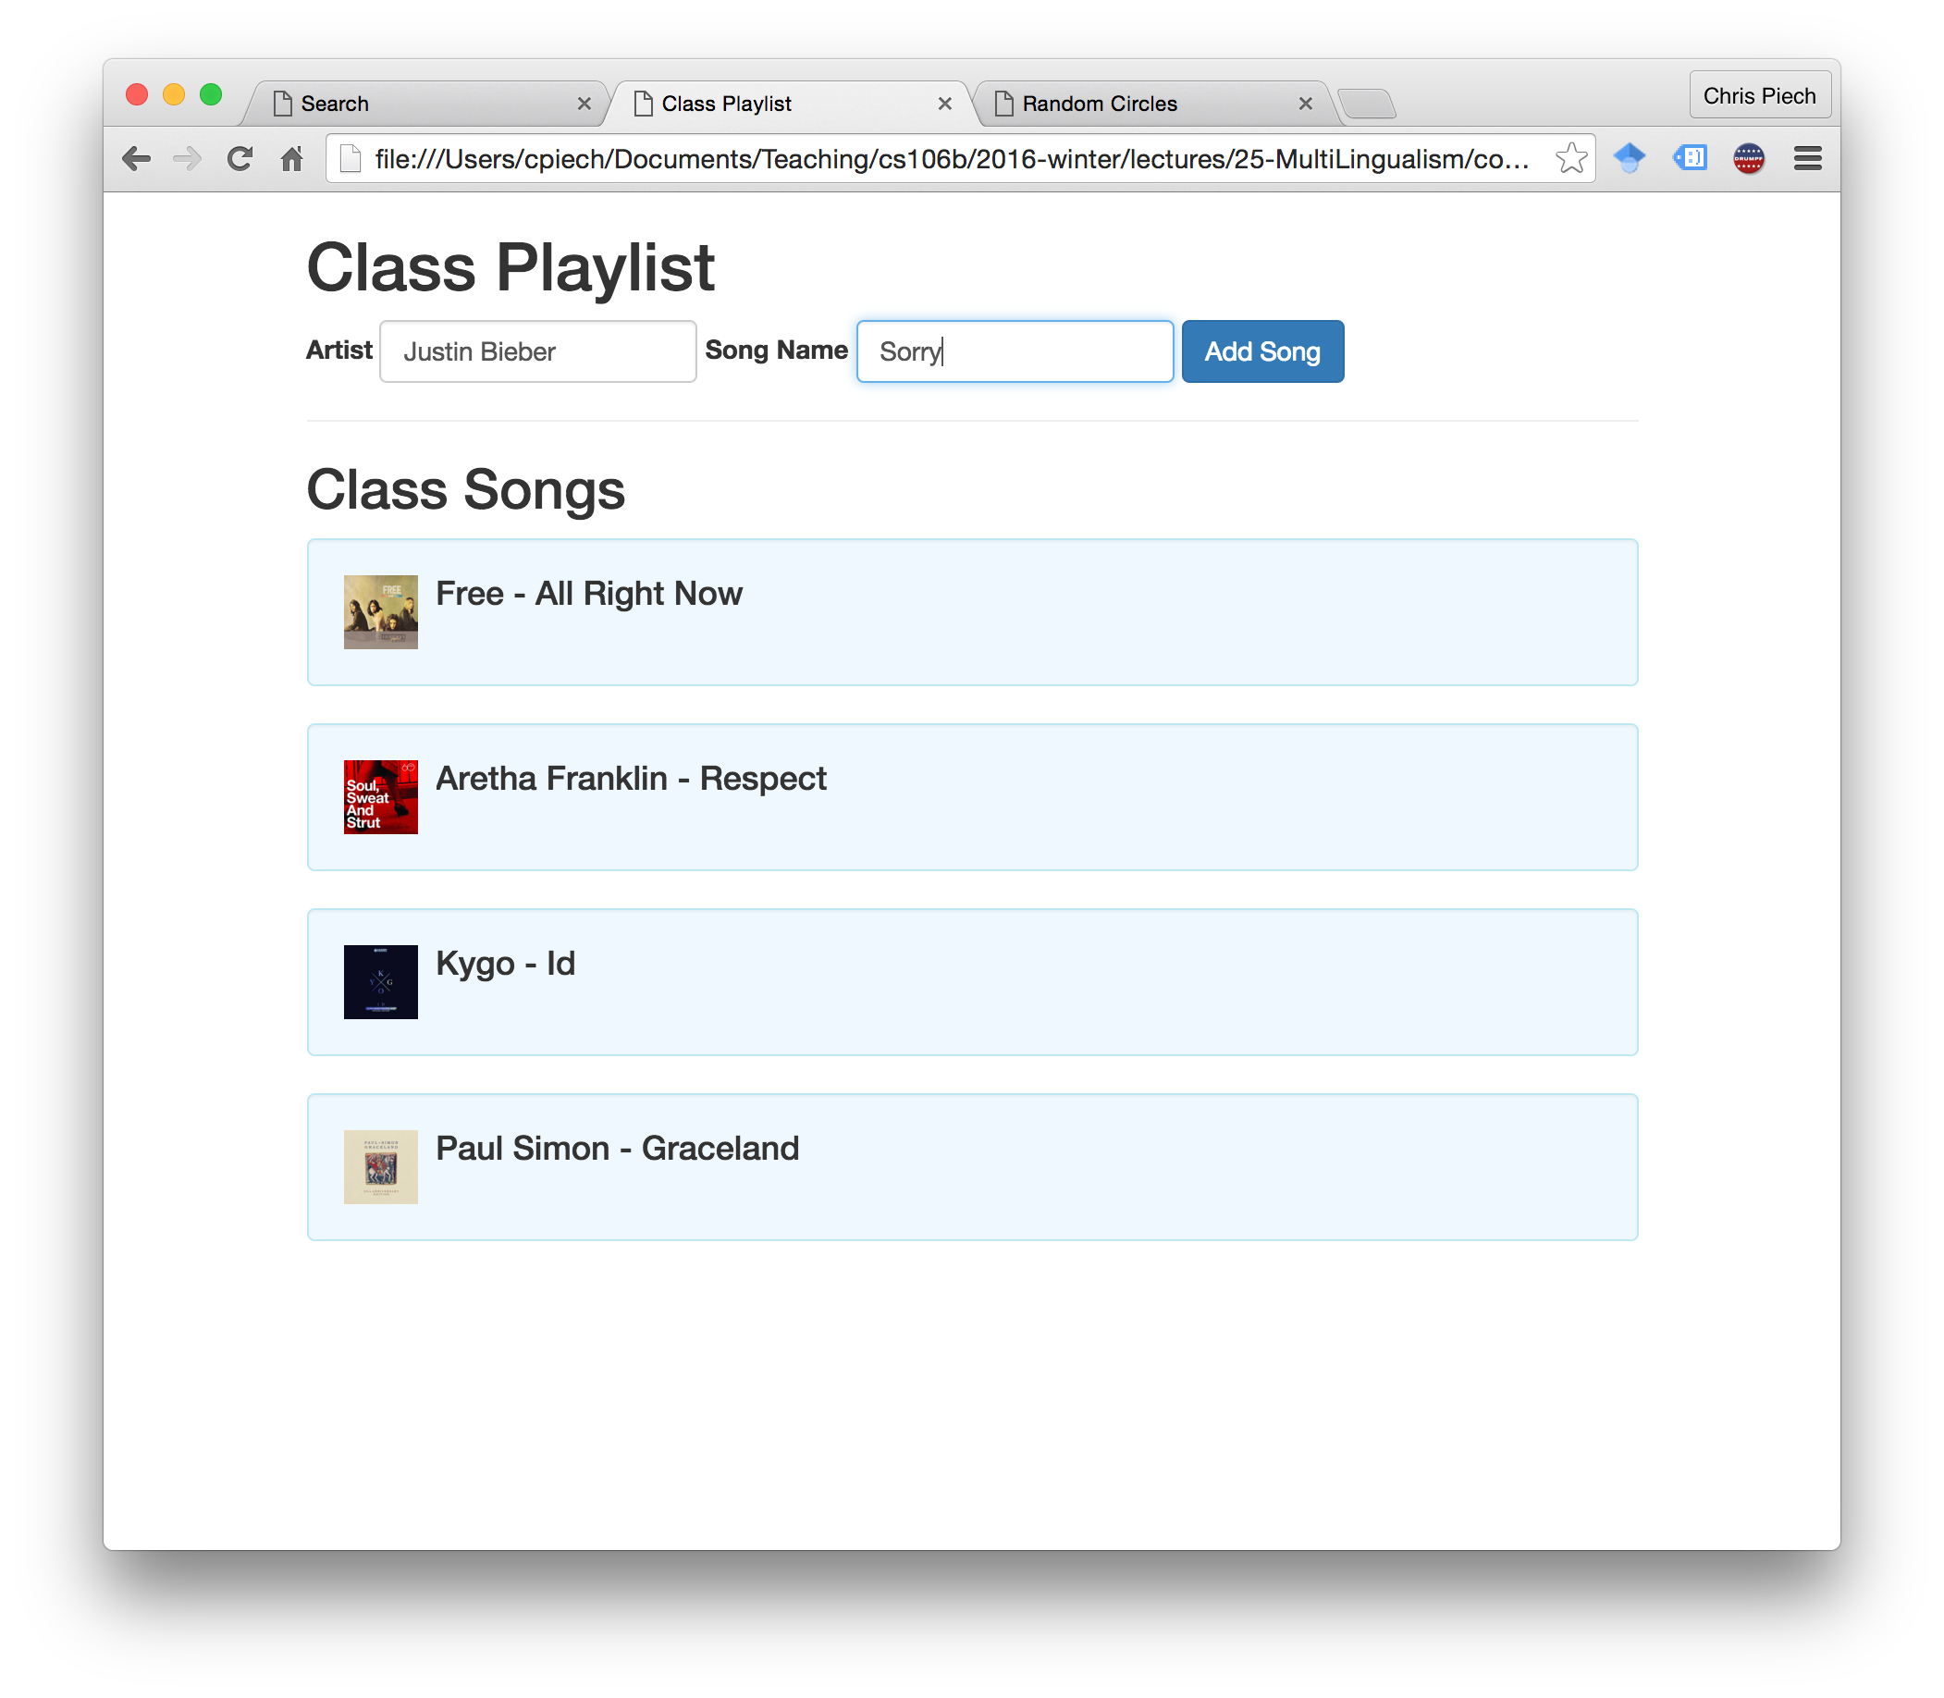
Program #3 Class Playlist

Slide 12
Website Programs?

Slide 13
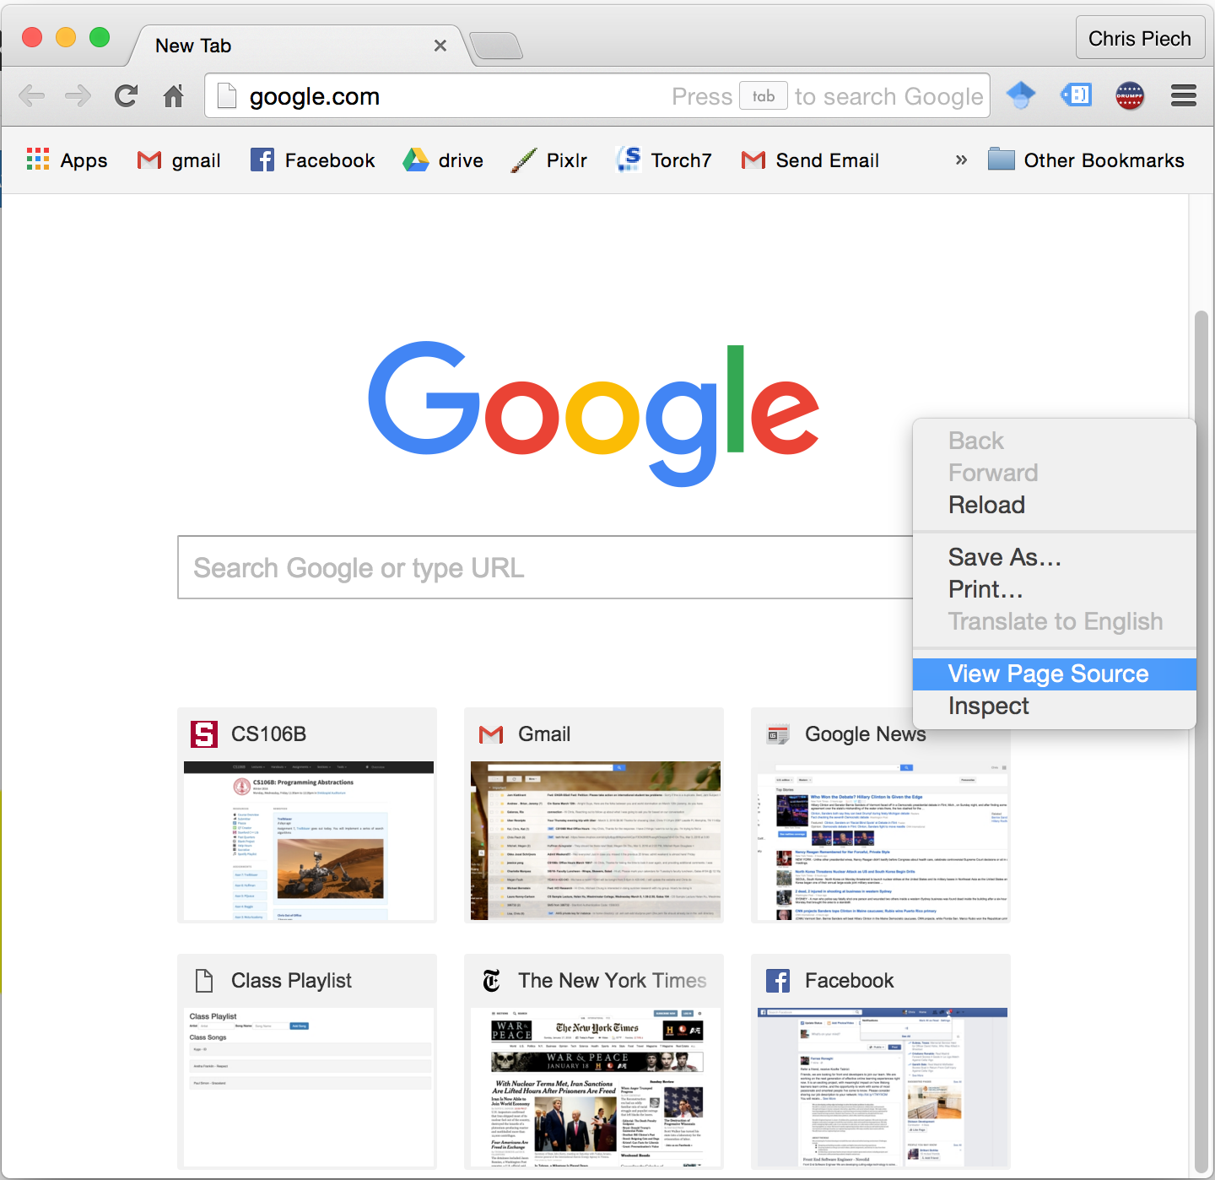
JavaScript, Language of the Web

Slide 14
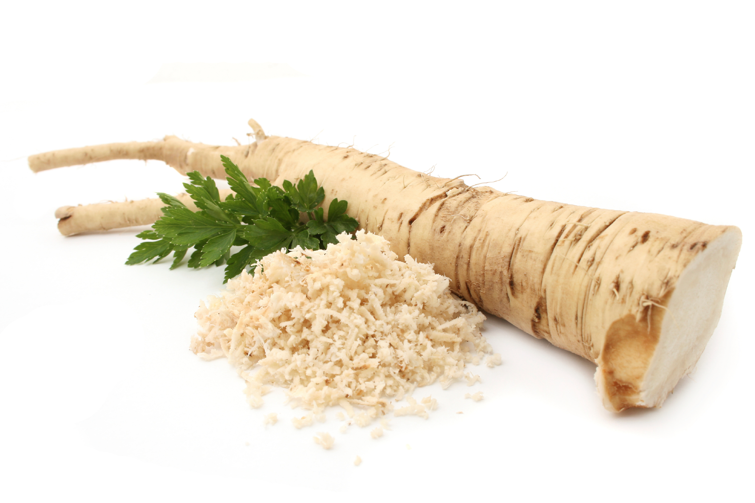
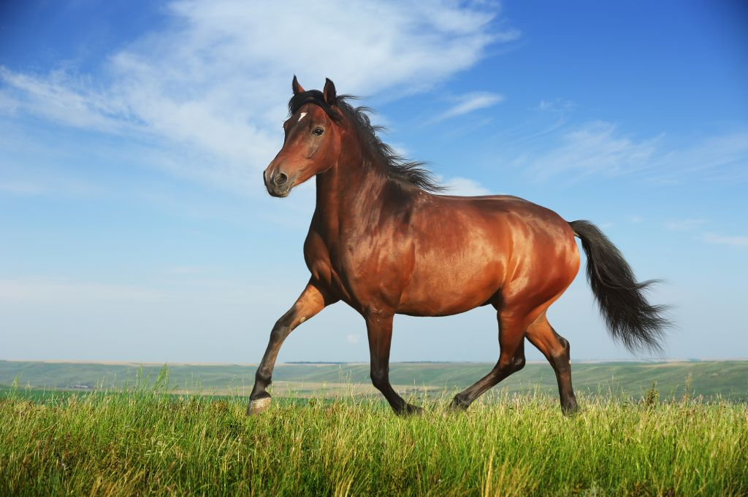


JavaScript is Not Java
:
:

Slide 15
Differences with C++
Works with HTML
No variable types
Not compiled
int division is changed
Maps, Vectors and Functions are first class types
Beyond CS106B:
Anonymous functions
No pause

Slide 16
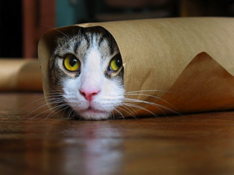
Pointers and Pass by Reference?
124134
image
Numbers passed by value.
Everything else passed by reference

Slide 17
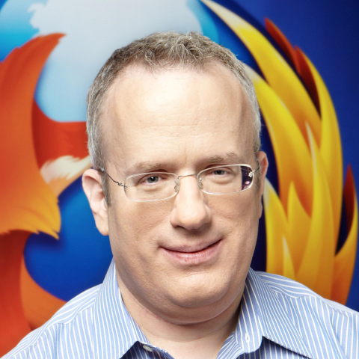
Written in 10 days
Brendan Eich

Slide 18
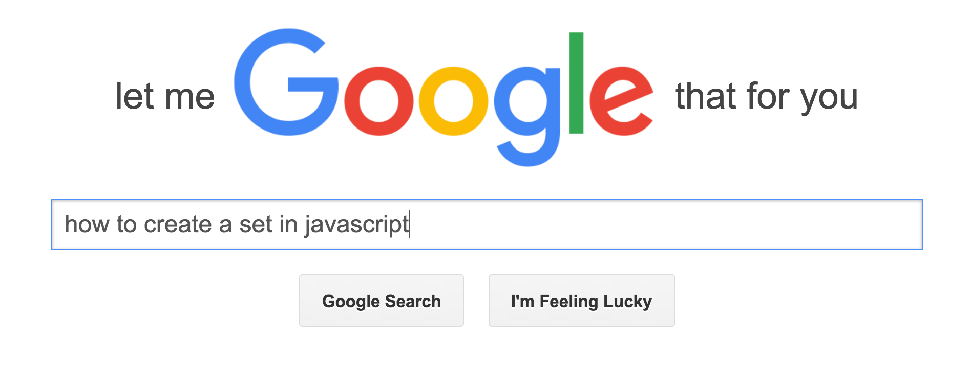
Cover Syntax
But its not the point of today

Slide 19
Lets give it a try!

Slide 20
Program #1 Random Circles

Slide 21
Elementary my dear Chris

Slide 22
Program #2 Breadth First Search

Slide 23
Is anything really different?

Slide 24
Program #3 Class Playlist

Slide 25

When You Navigate to a Website
Facebook.com

Slide 26
http://facebook.com

Slide 27
Web Applications
Facebook.com

Slide 28

Web Applications
Probably in Greenland
or something
Facebook.com
128.234.233.442

Slide 29
Web Applications
wifi
optical cables
Facebook.com
128.234.233.442

Slide 30
Each router has run a search algorithm

Slide 31
Dijkstra? BFS? A-Star?

Slide 32
Dijkstra

Slide 33
Web Applications
wifi
optical cables
Facebook.com
128.234.233.442

Slide 34
Web Applications
Facebook.com
128.234.233.442

Slide 35
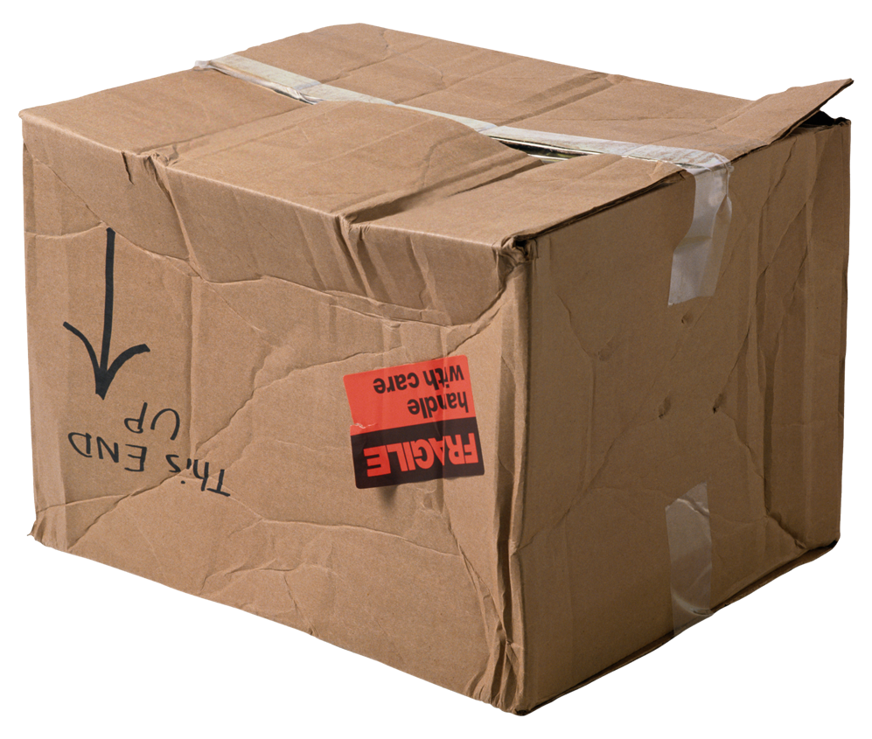
Web Applications
Website,
please
Facebook.com
128.234.233.442

Slide 36
Web Applications
HTML and
JS
Facebook.com
128.234.233.442

Slide 37
Web Applications
Facebook.com
128.234.233.442

Slide 38
Web Applications
Data
Request
Facebook.com
128.234.233.442

Slide 39
Server Data Requests
Request
response
Facebook.com
128.234.233.442

Slide 40
Web Applications
Add
friend
Facebook.com
128.234.233.442

Slide 41
Web Applications
Success!
Facebook.com
128.234.233.442

Slide 42
You Write Two Programs
Client code
Server code
Python
Java
C++
JavaScript

Slide 43
Program #3 Class Playlist

Slide 44
http://localhost:8888/getSongs

Slide 45
This is a public request
http://localhost:8888/getSongs

Slide 47
http://localhost:8888/addSong?artist=kygo&songName=id

Slide 48
http://localhost:8888/addSong?artist=kygo&songName=id
put desired artist here
put desired songName here

Slide 49
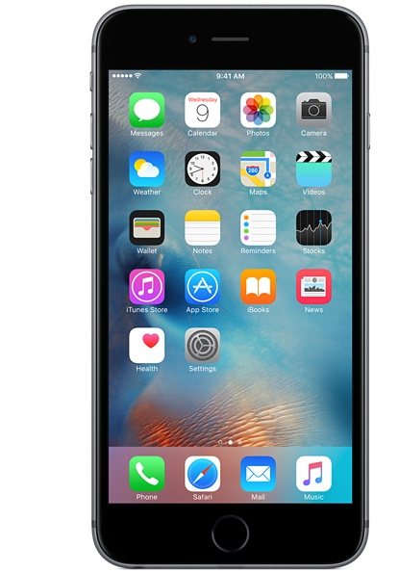
Paradigm Applies to Mobile Too
4G
Facebook.com
128.234.233.442

Slide 50
Program #3 Class Playlist

Slide 51
You can learn any language you want

Slide 52
Today’s Goal
Multilingualism
How the web works
Javascript Ideas

Slide 53
Learn JavaScript
CS42
Learn on
your own

Slide 54
You have free website space at Stanford

